Slide 1
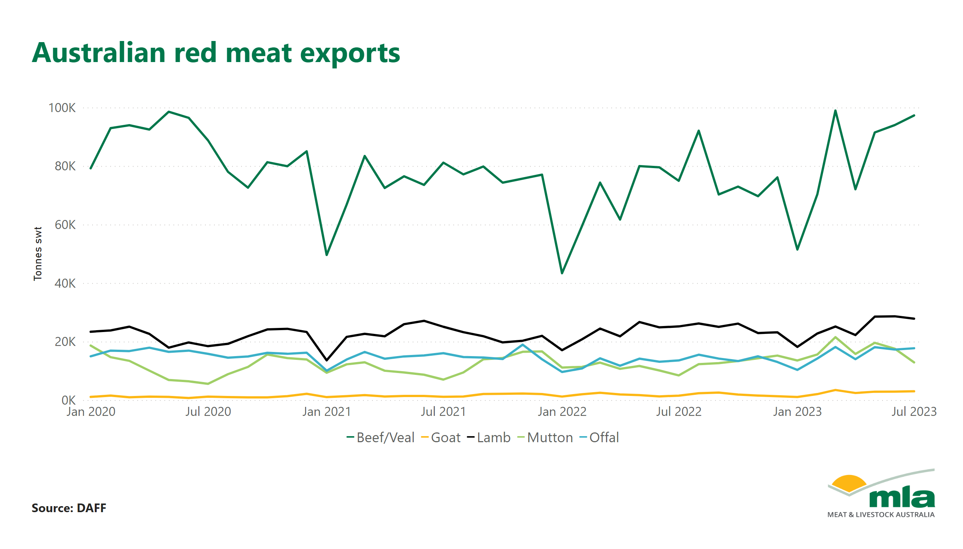
AU Red Meat exports

Slide 2
Exports by Product

Slide 3
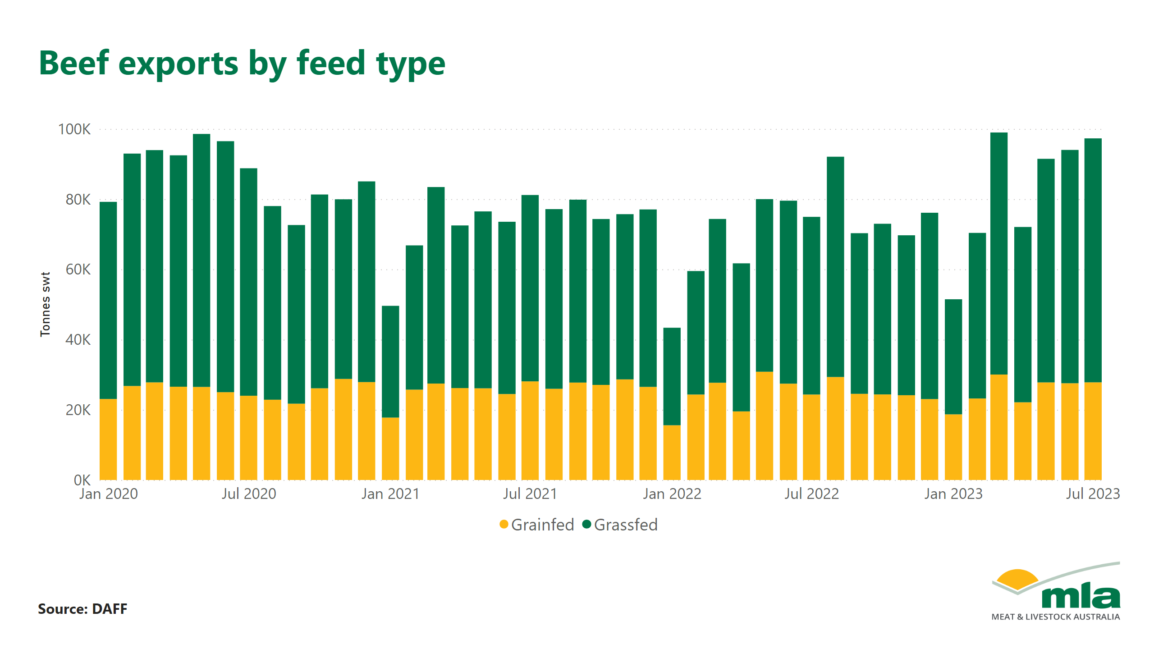
Beef by feed

Slide 4
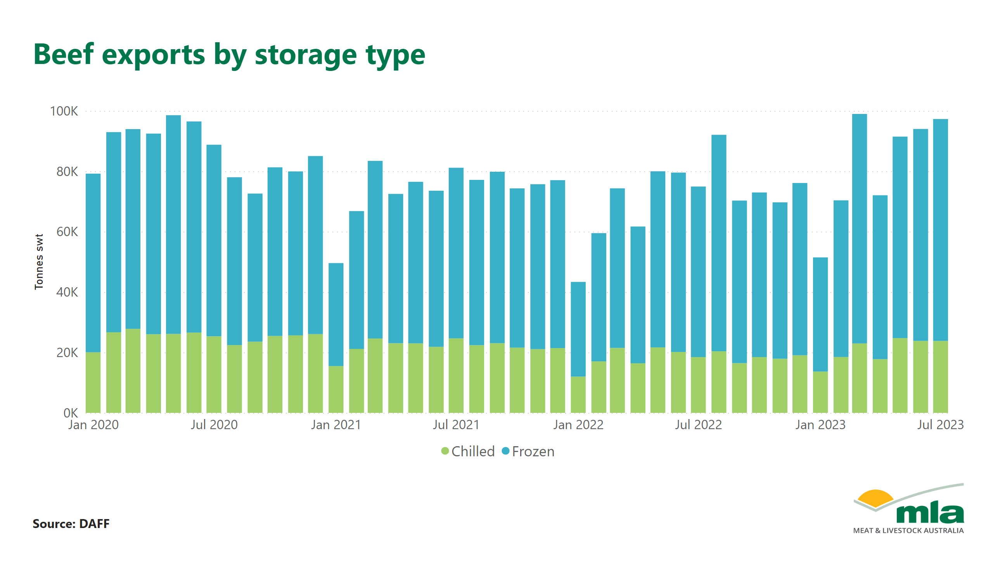
Beef by storage

Slide 5
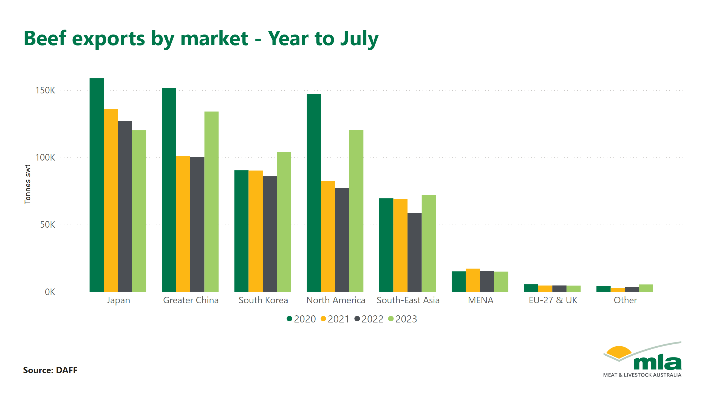
Beef by market

Slide 6
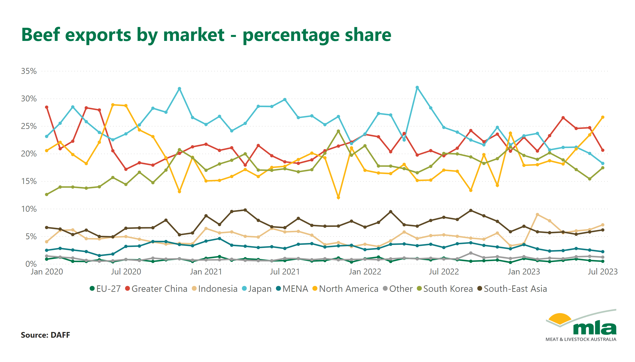
Beef by market - percentage

Slide 7
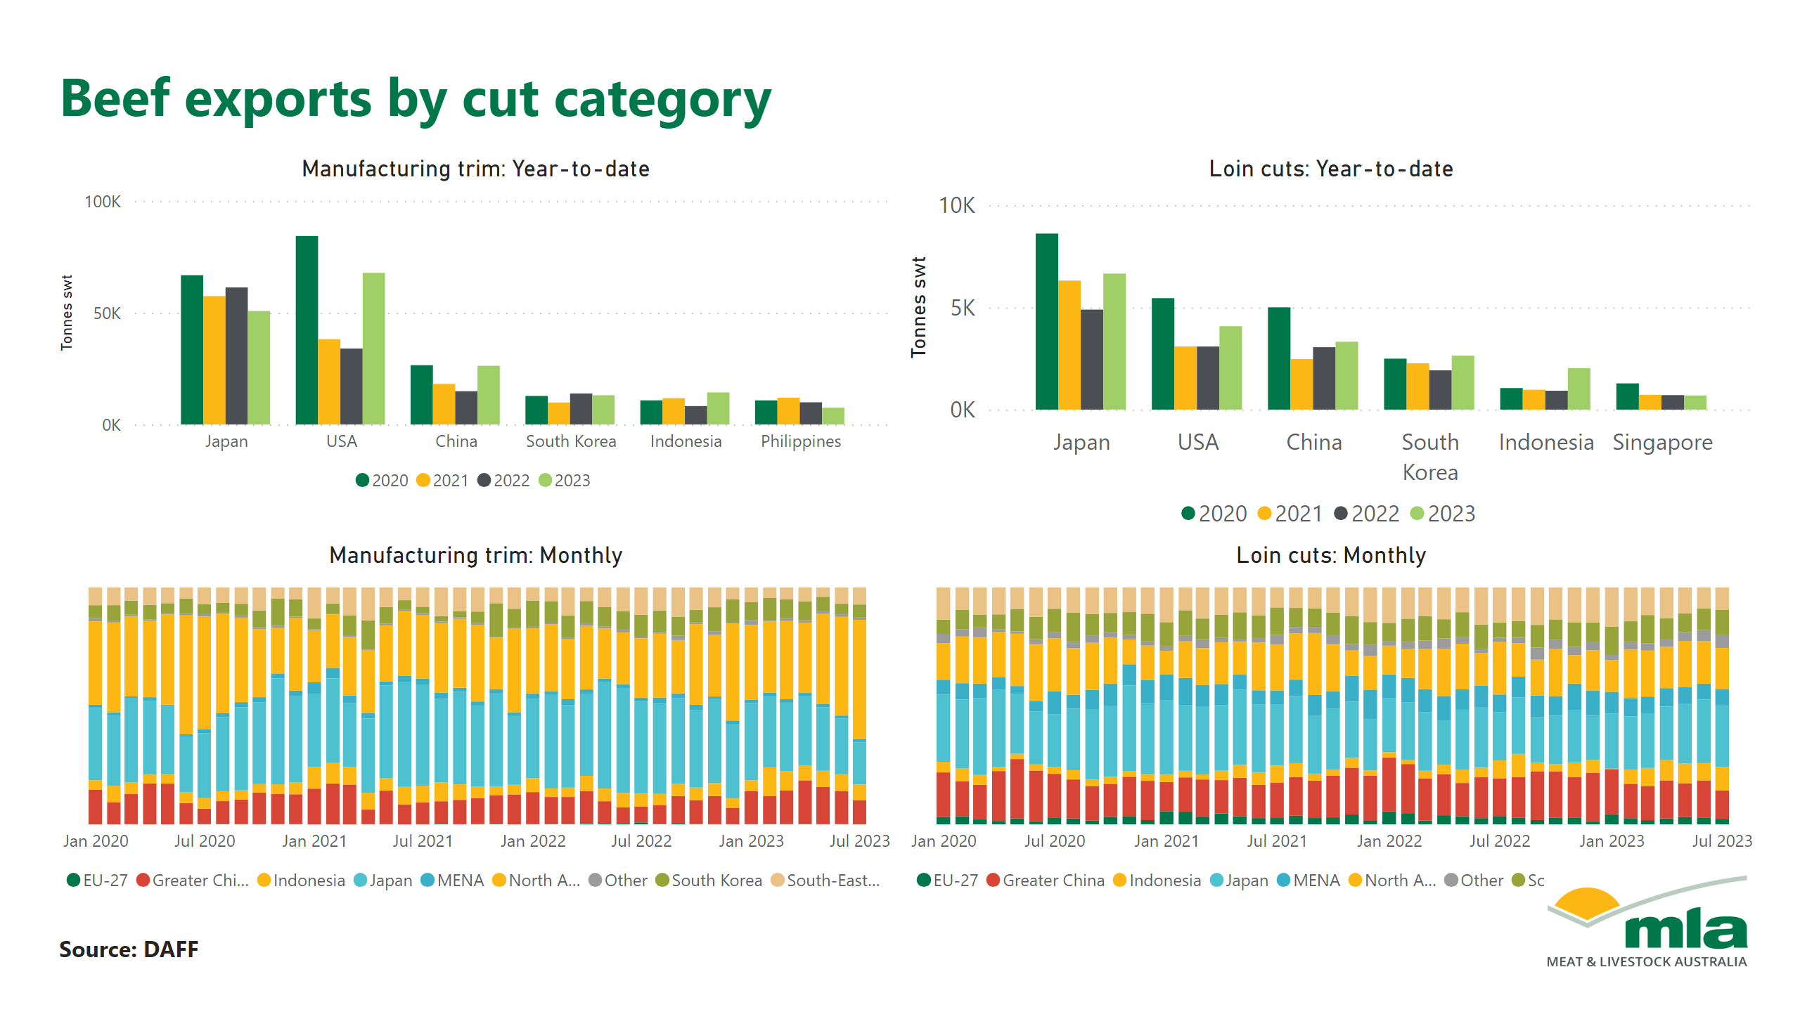
Beef by cut

Slide 8
Beef by cut 2

Slide 9
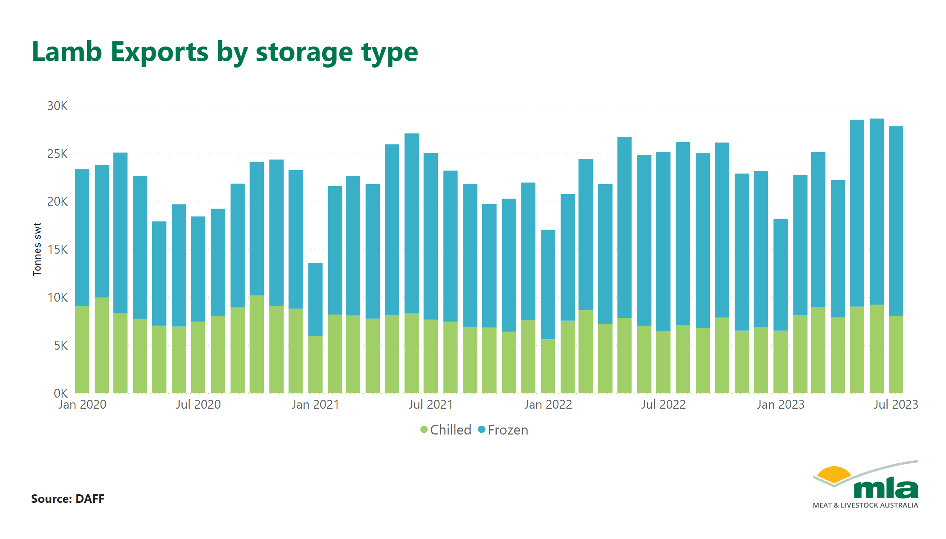
Lamb by Storage

Slide 10
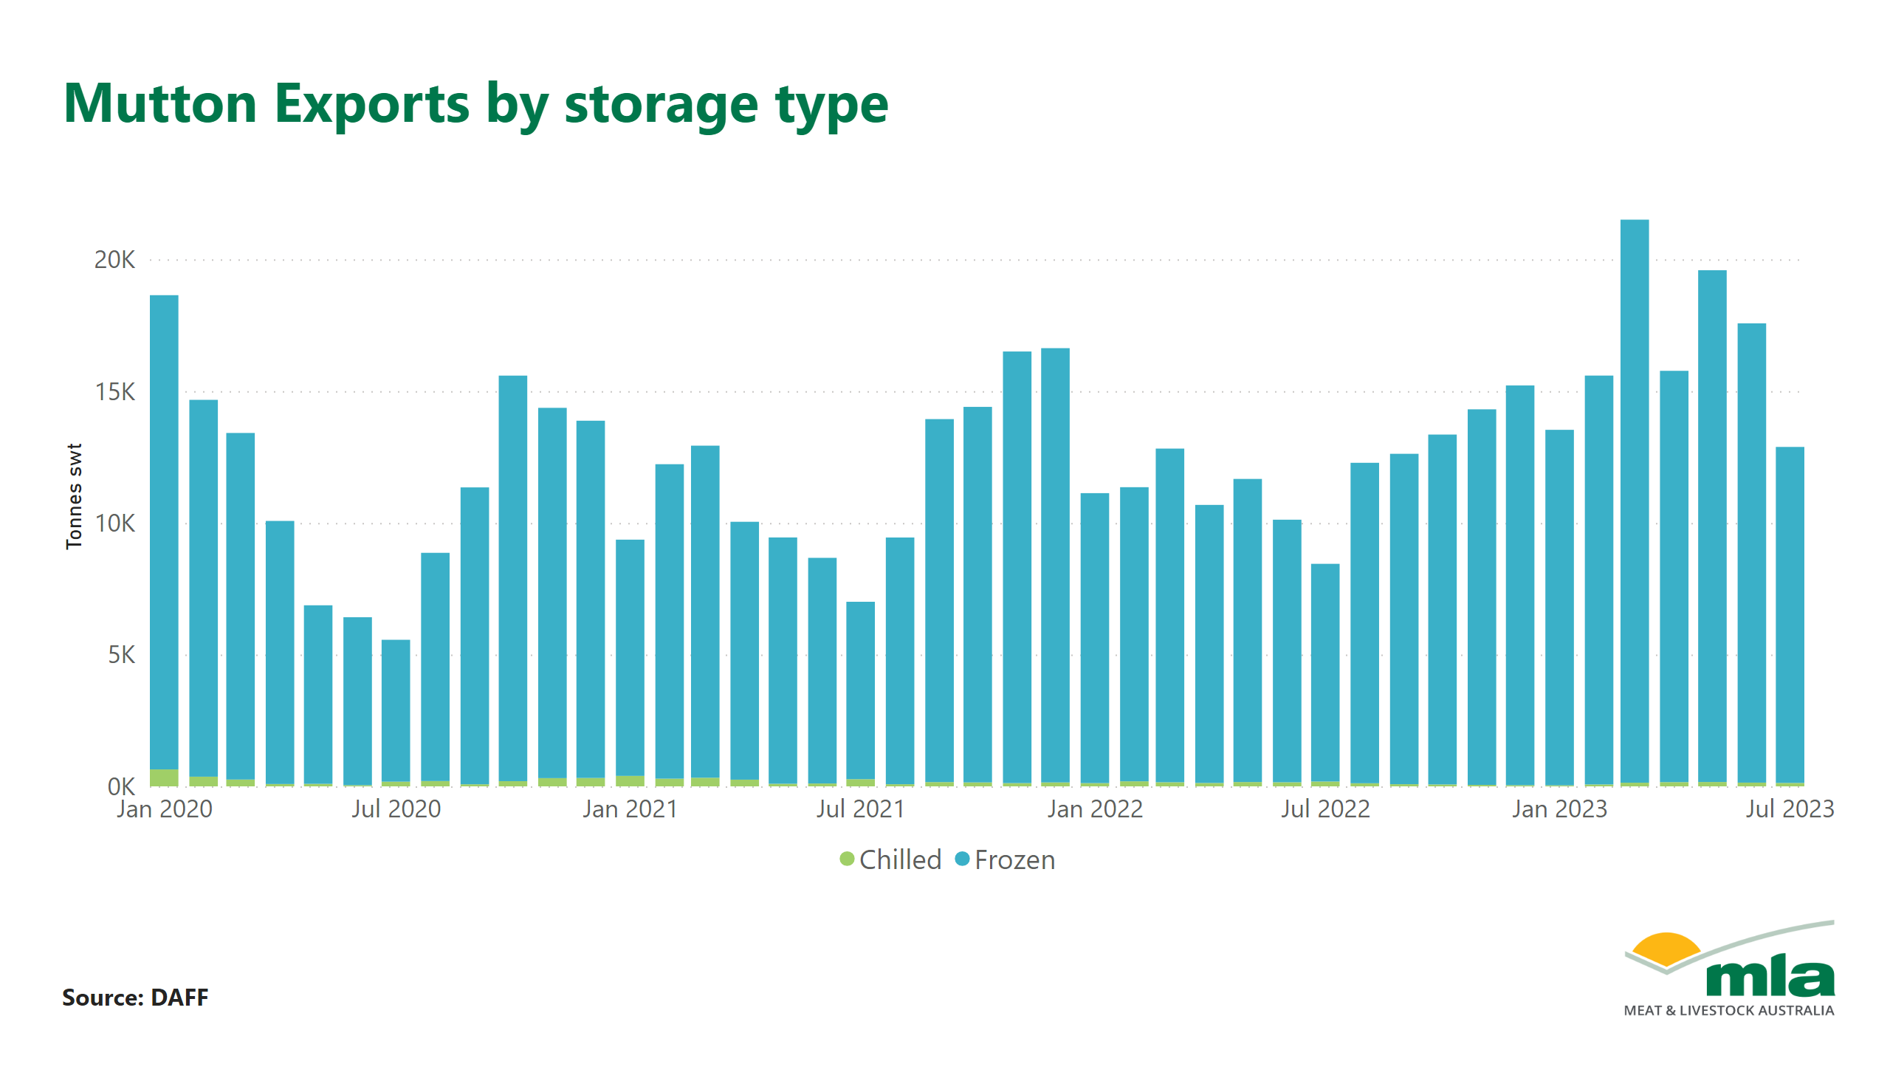
Mutton by storage

Slide 11
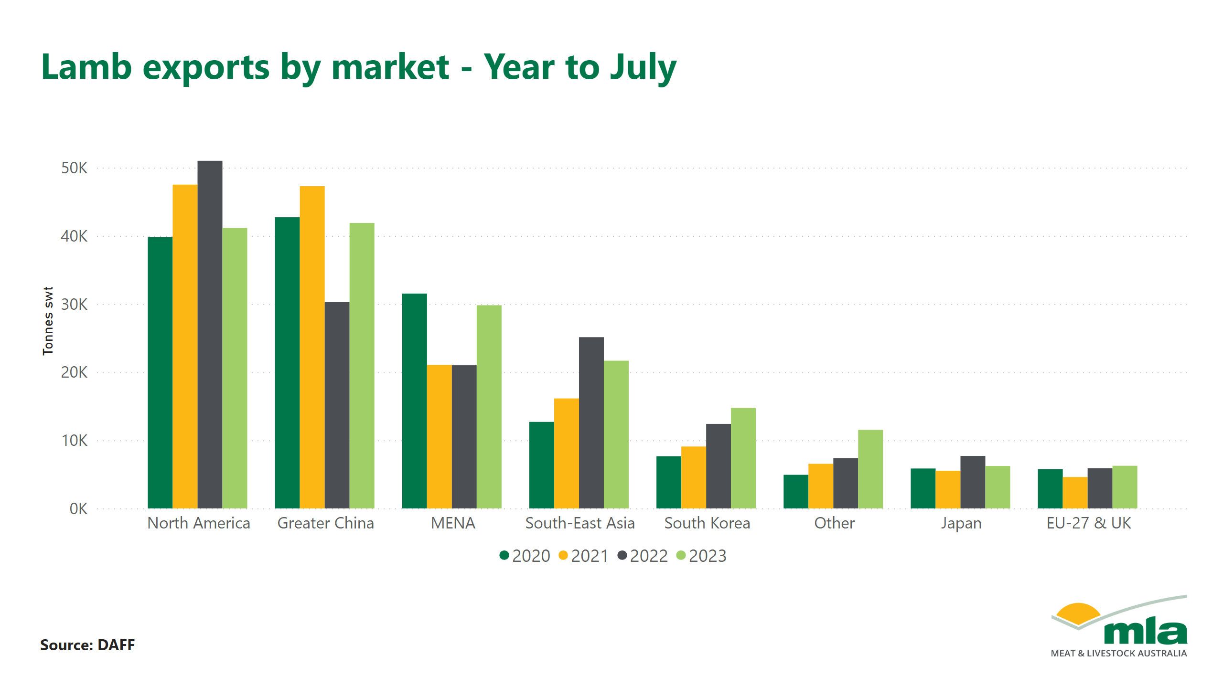
Lamb by market

Slide 12
Lamb by market - percent

Slide 13
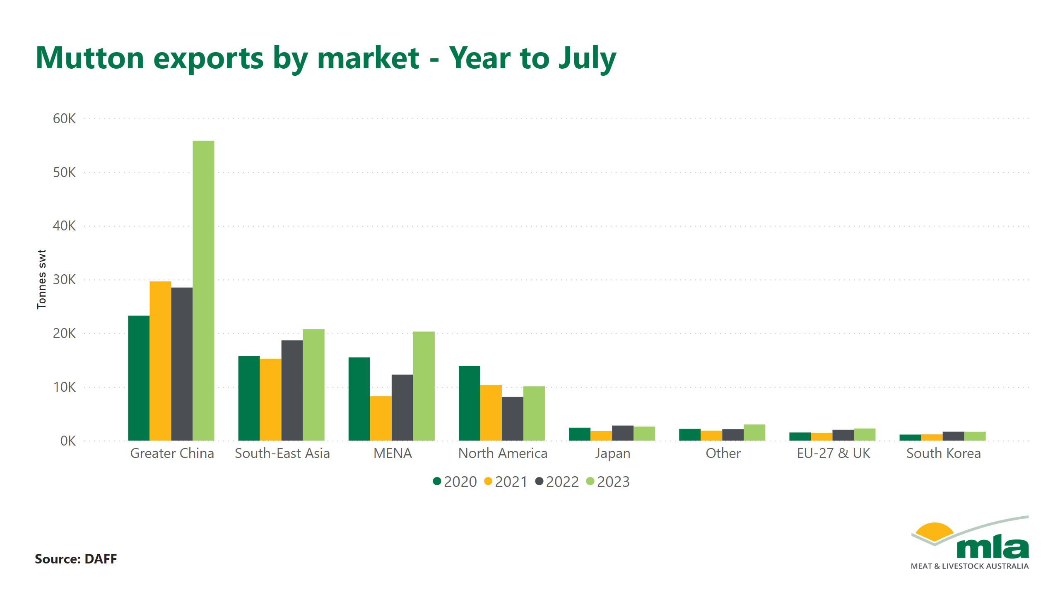
Mutton by Market

Slide 14
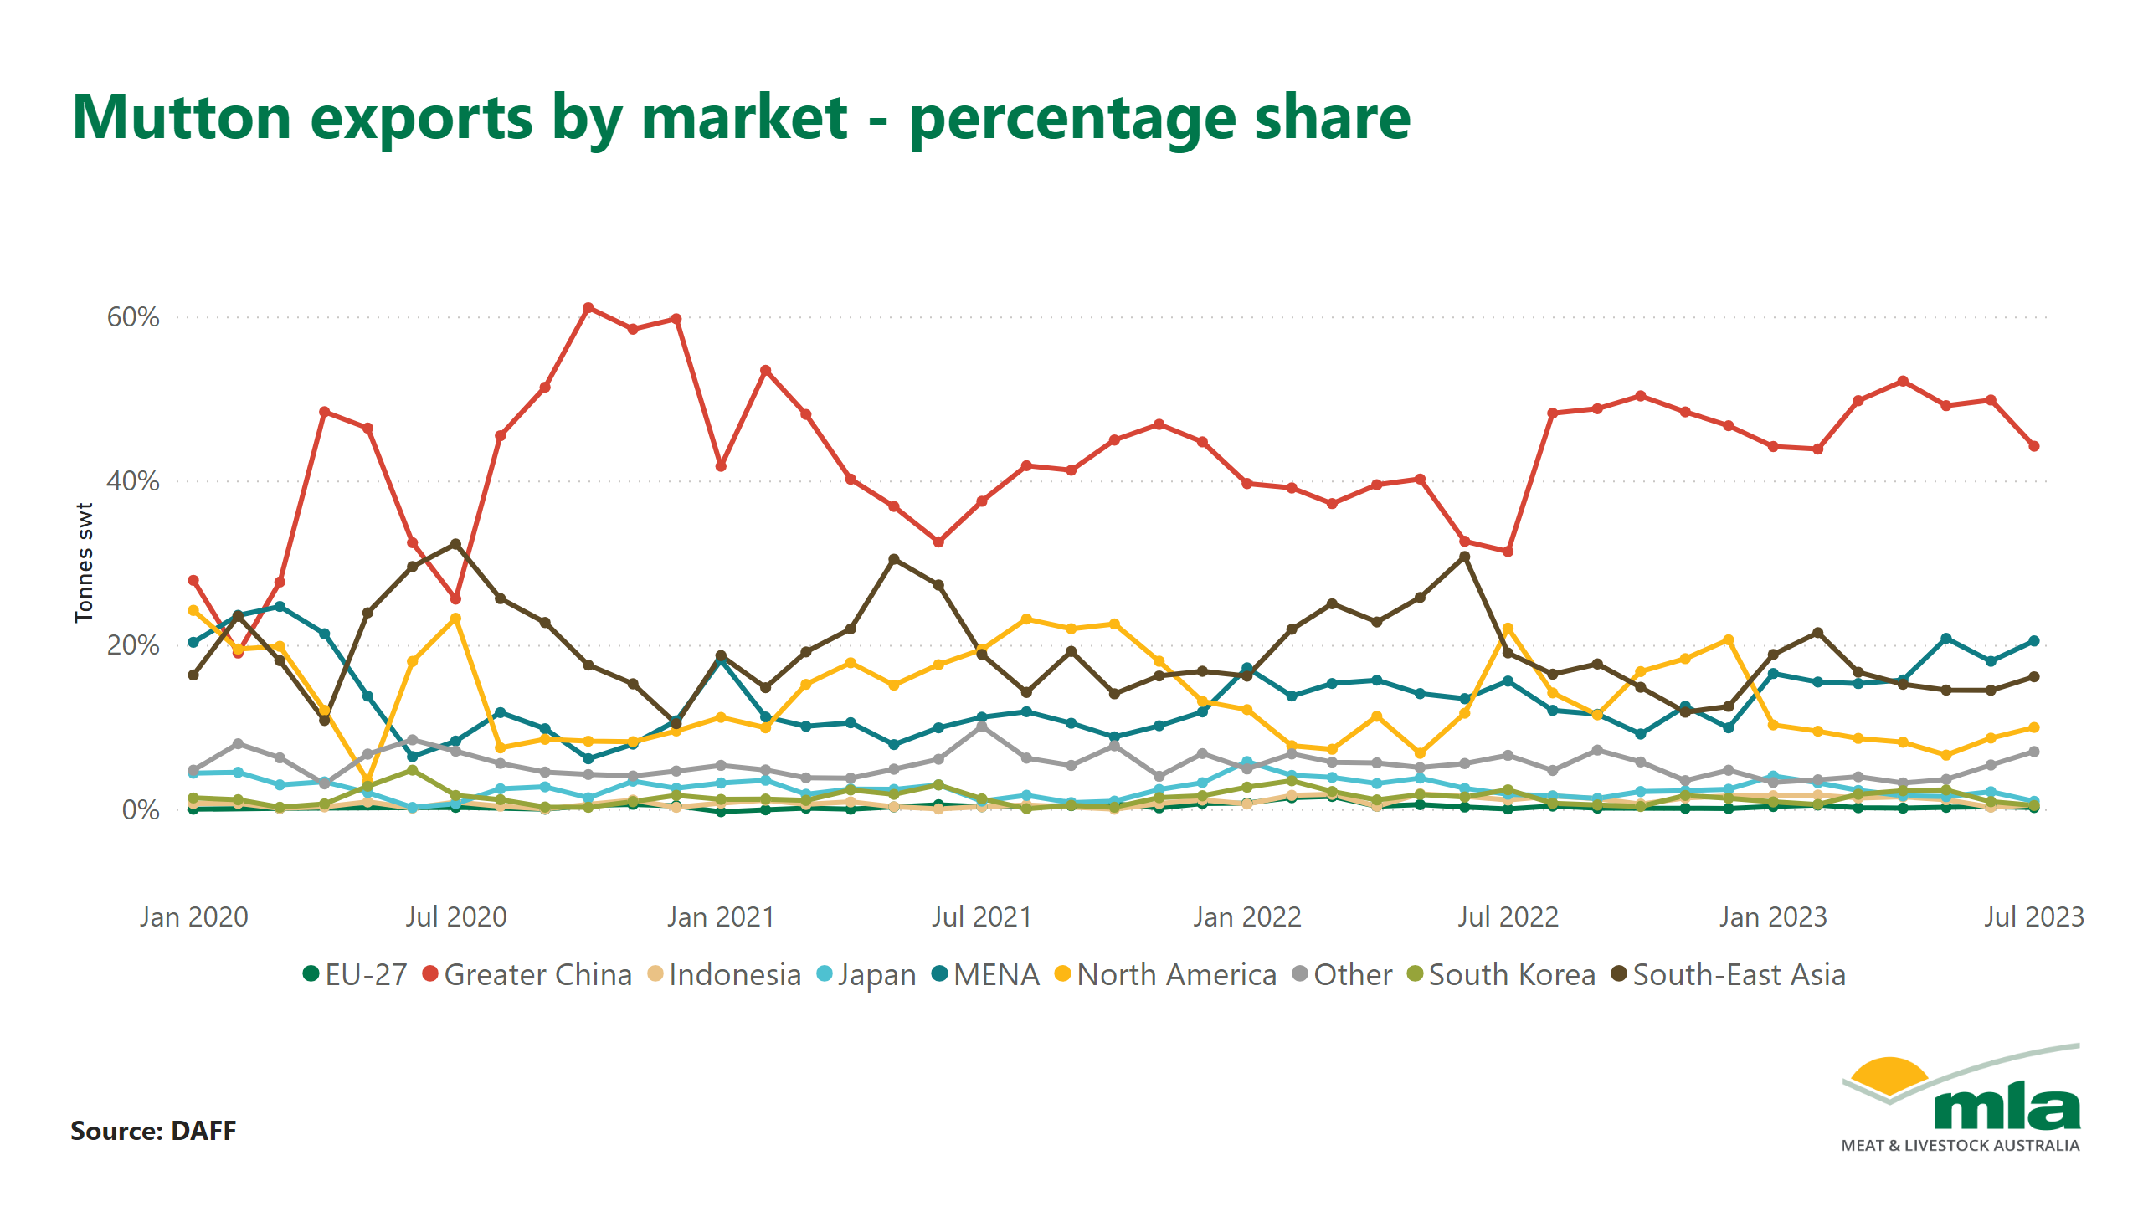
Mutton by market - percent

Slide 15
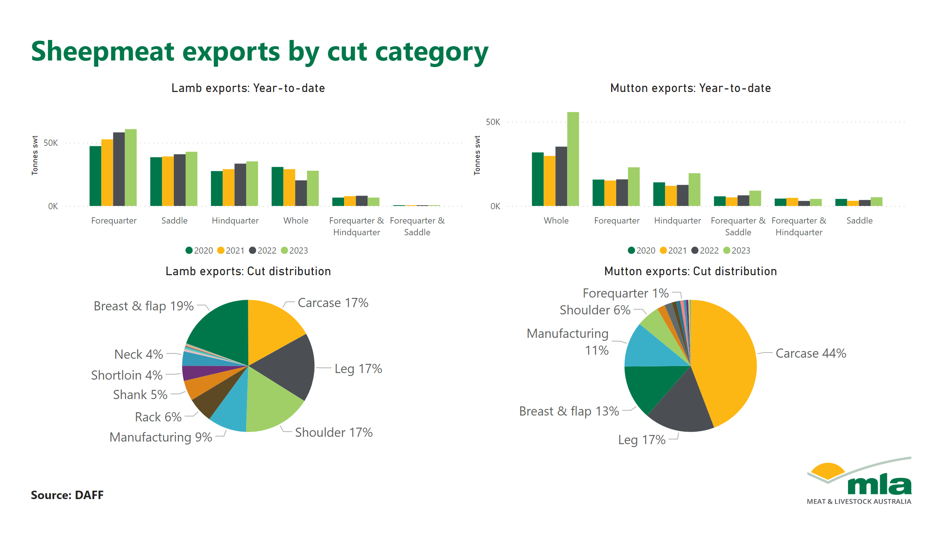
Sheepmeat by cut

Slide 16
Lamb by cut

Slide 17
Page 17

Slide 18
Mutton by cut

Slide 19
Page 19

Slide 20
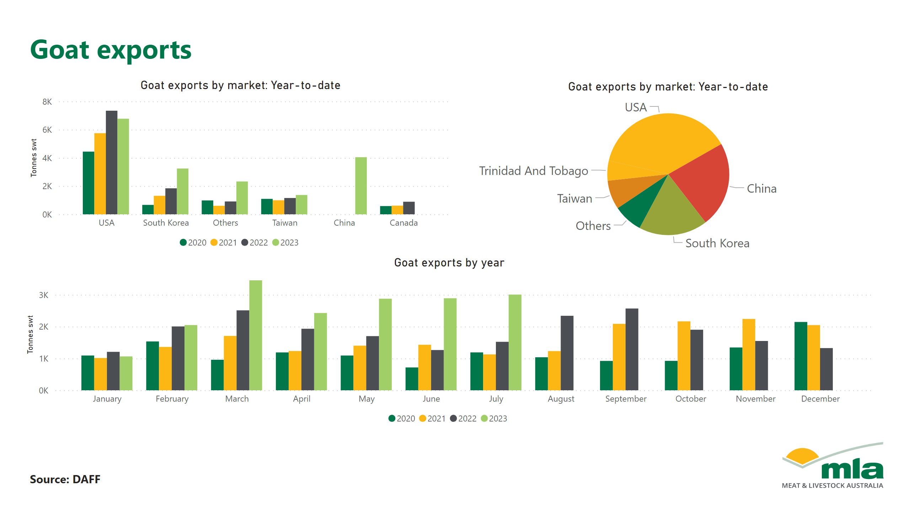
Goat exports

Slide 21
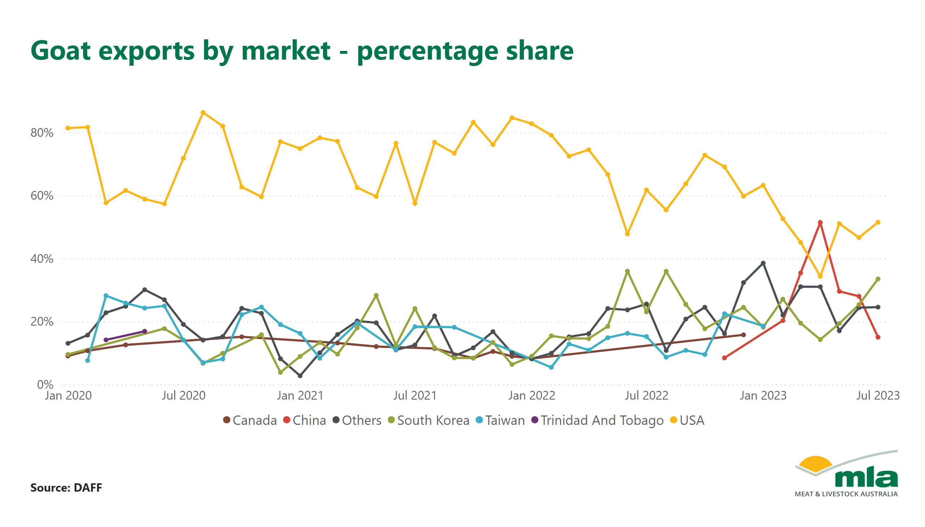
Duplicate of Page 6

Slide 22
Exports to Japan

Slide 23
Exports to USA

Slide 24
Exports to North America

Slide 25
Exports to Greater China

Slide 26
Page 22 (1)

Slide 27
Exports to South Korea

Slide 28
Exports to EU

Slide 29
Exports to UK

Slide 30
Exports to SE-Asia

Slide 31
Page 27

Slide 32
Exports to MENA

Slide 33
Page 29

